Slide 1
VEHICLE-TO-VEHICLE (V2V) COMMUNICATION SYSTEM
FOR SAFE AND EFFICENT TRAVEL
Round II Submission for I. Mobilathon
By M.Sc. Data Science Students
TEAM MEMBERS:
1. K. Vasanth
2. A. Pravinkumar
3. P. Gokul
4. G.M. Harsha

Slide 2

PROBLEM STATEMENT
Drivers face issues with:
Traffic congestion
Road hazards
Weather unpredictability
These problems result in longer travel times, risks to safety, and inefficiencies.

Slide 3
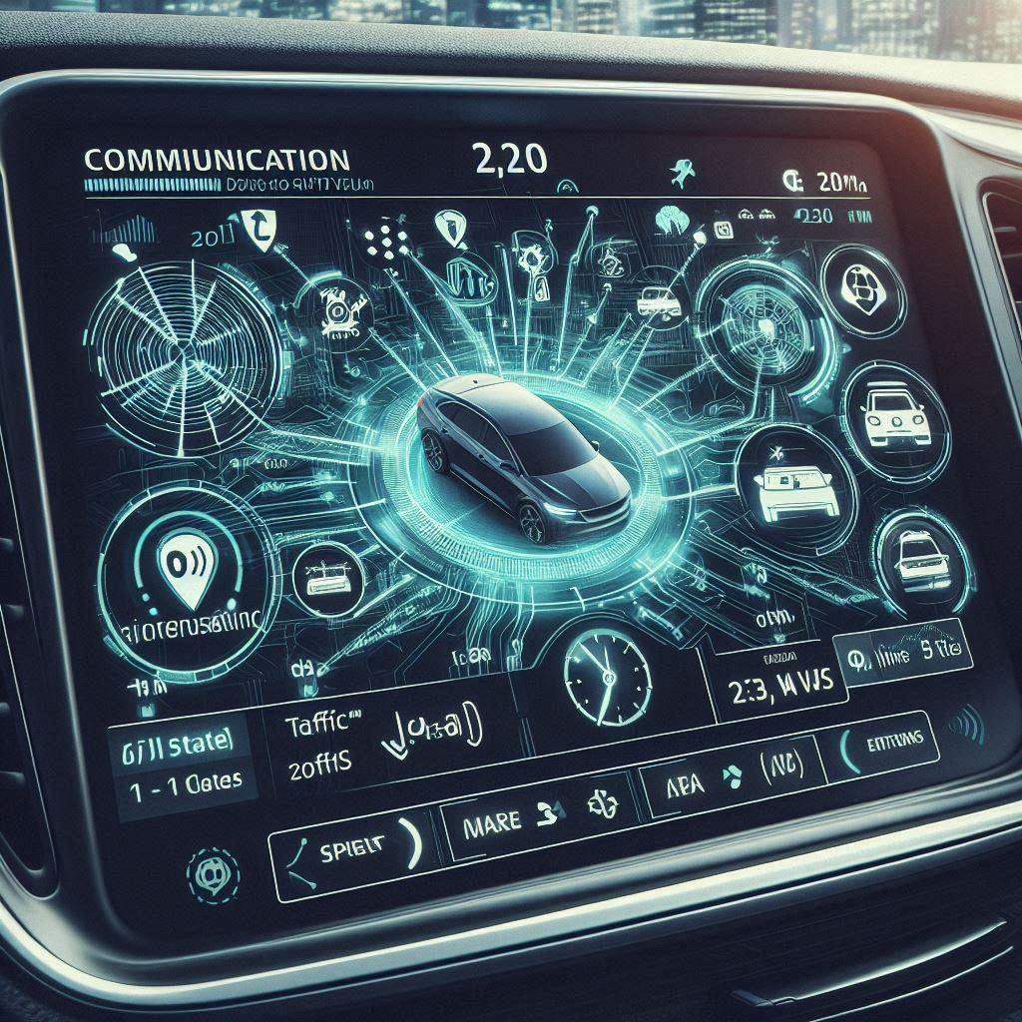
PROPOSED SOLUTION
Our V2V Communication System lets vehicles share real-time data like speed, traffic info, and road conditions.
This information is shared instantly with other vehicles to ensure safe and efficient routes.

Slide 4
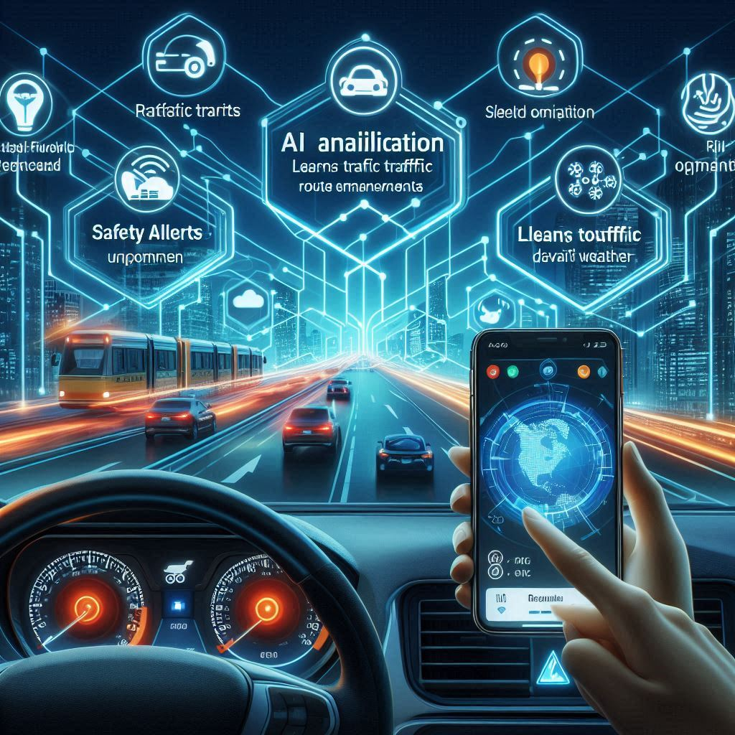
KEY FEATURES OF THE V2V SYSTEM
Route Optimization: Real-time traffic updates ensure efficient routes.
Safety Alerts: Warns drivers of upcoming hazards and adverse weather.
AI Analysis: Learns traffic patterns for predictive route enhancements.

Slide 5
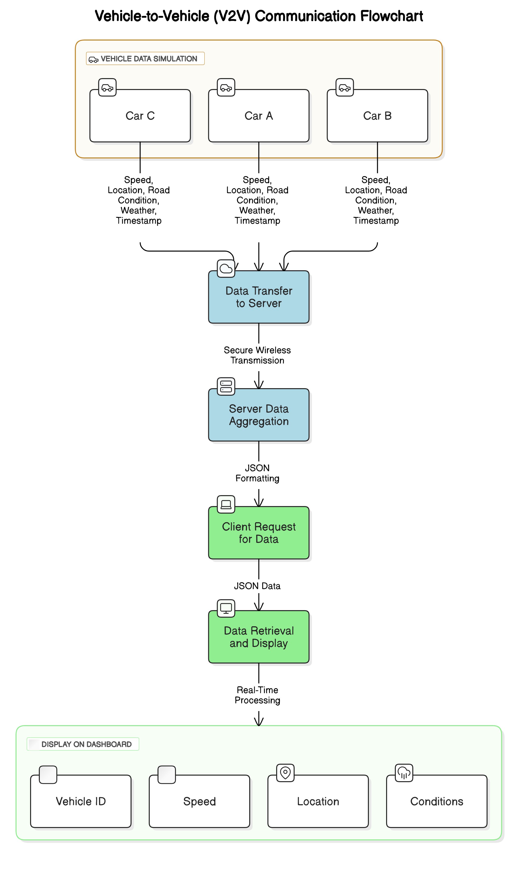
SYSTEM ARCHITECTURE

Slide 6
HOW IT WORKS
Choose Destination
User selects the destination in Car A's system.
Real-Time Data Sharing
Nearby cars (Car B, Car C, Car D) share:
Speed, traffic, weather, and road conditions.
Data Processing
AI analyzes the data to find the best route.
Route Recommendation
Car A displays:
Fastest route, travel time, and alerts.
Live Updates
Routes update based on real-time changes.

Slide 7
REQUIRED SOFTWARE DEVLOPMENT KIT
Backend Development
Python: Core language for backend logic.
Flask: Framework for server and API development.
SQLite: Lightweight database for vehicle data storage.
Frontend Development
HTML, CSS, JavaScript: Building user dashboards.
Chart.js: Data visualization (e.g., graphs and charts).
Bootstrap: Responsive design.

Slide 8
Real-Time Communication
Socket.IO: For real-time data sharing.
MQTT: Lightweight protocol for IoT communication.
Data Analytics
Pandas: Data processing and analysis.
Scikit-learn: Machine Learning for route optimization.
Deployment
Heroku/AWS: Cloud hosting for backend and dashboard.
Docker: For containerized deployment.

Slide 9
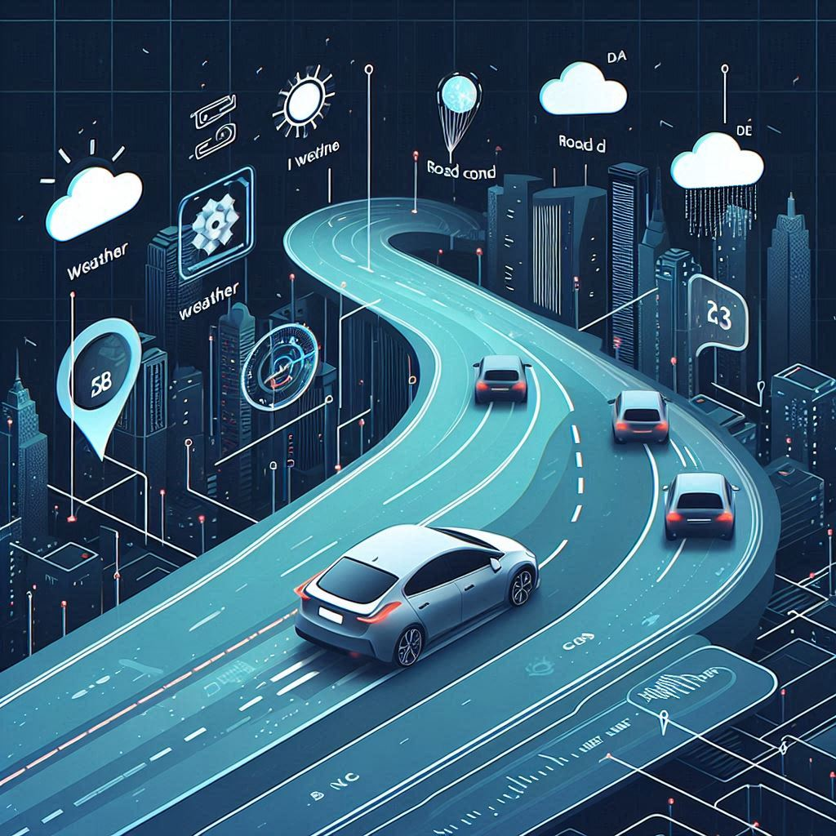
BENEFITS OF V2V COMMUNICATION
Shorter travel times with fewer delays.
Increased safety through real-time alerts.
Better fuel efficiency by reducing idling and unnecessary stops.

Slide 10
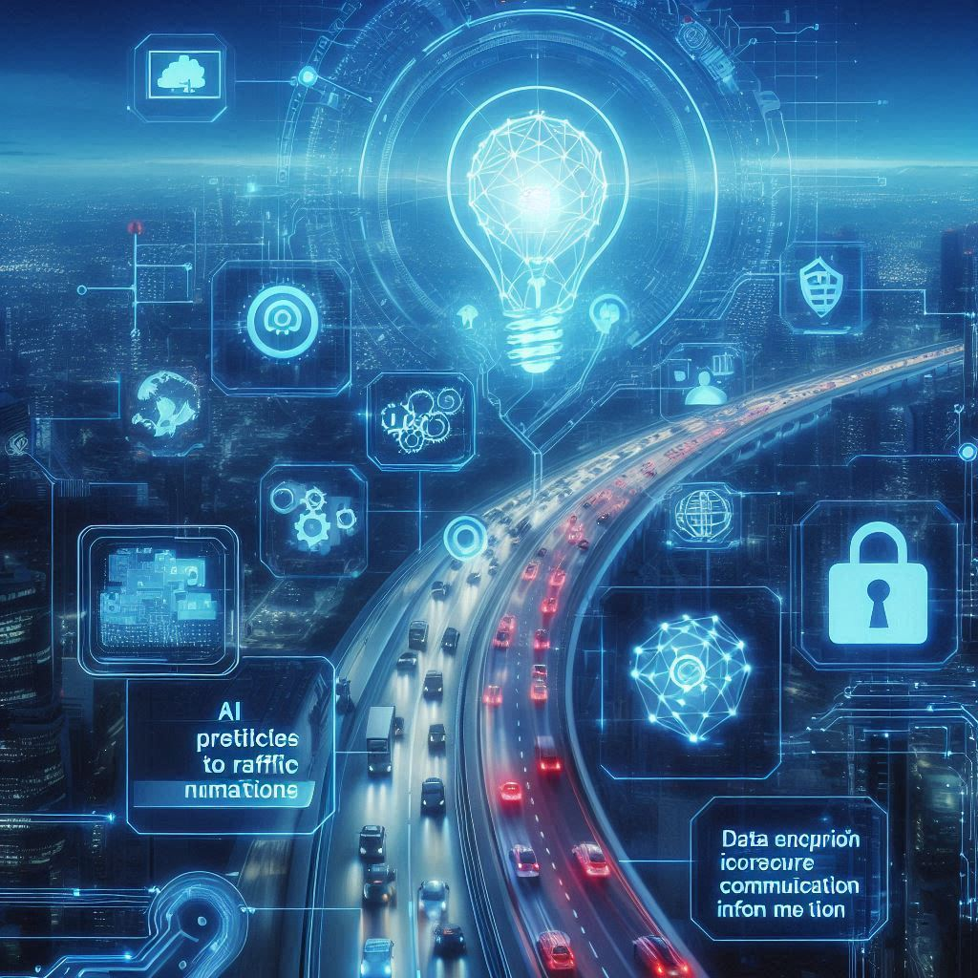
SECURITY AND AI INTEGRATION
AI predicts traffic patterns to refine routes over time.
Data encryption ensures secure communication, protecting sensitive information.

Slide 11
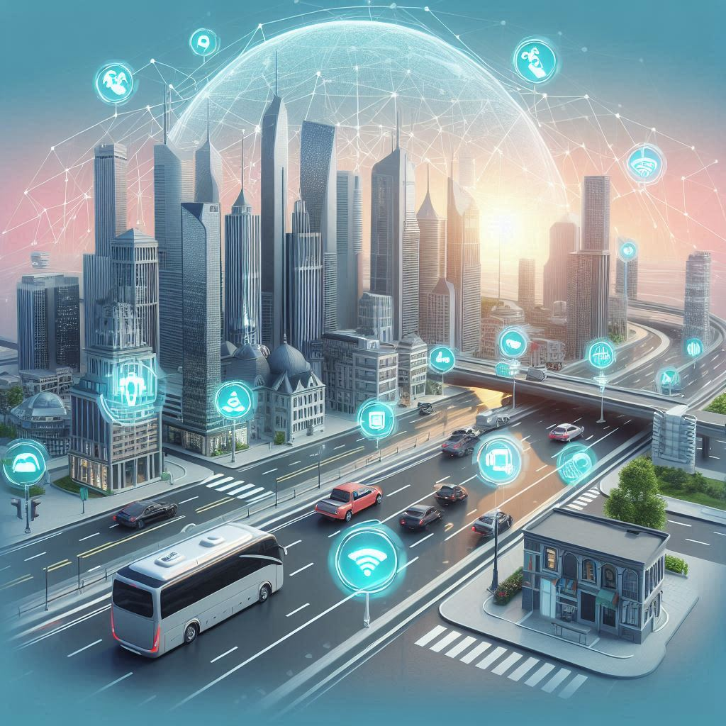
FUTURE SCOPE AND CONCLUSION
Expansion to include smart city infrastructure.
Adaptation for autonomous vehicle networks.
Conclusion: The V2V system marks a step towards intelligent and safer roadways.

